Slide 1
Colinearity

Slide 2
Colinearity
We usually pleased when there is strong correlation between y and our explanatory variables, (x₁, x₂, . . . , x_{k}).
This means that we have variables that explain y.
Our t-stats will be large and our p-values will be small. This indicates that the relationships are statistically significant.
What happens though when there is strong correlation between the explanatory variables themselves?
When at least two explanatory variables, say xj and xi , are strongly correlated our regression exhibits colinearity.
This is not a problem, per se, but is an issue that should be recognized.

Slide 3
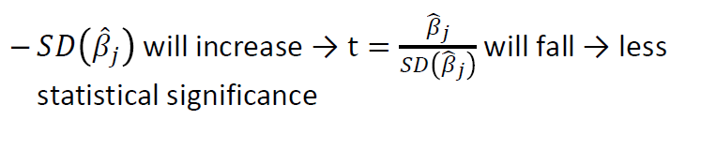
Consequences of Colinearity
The effects of colinearity are only felt by the variables that are highly correlated with each other.
Say x_{j} is highly correlated with at least one other explanatory variable. If that is true then:

Slide 4
Consequences of Colinearity
When two variables are highly correlated, and both are included in the regression, it is difficult to distinguish between one variable’s effect and the other variable’s effect.
It is like both variables are fighting to explain y and in the process neither may look statistically significant.
These consequences increase as the correlation between the explanatory variables increases.

Slide 5
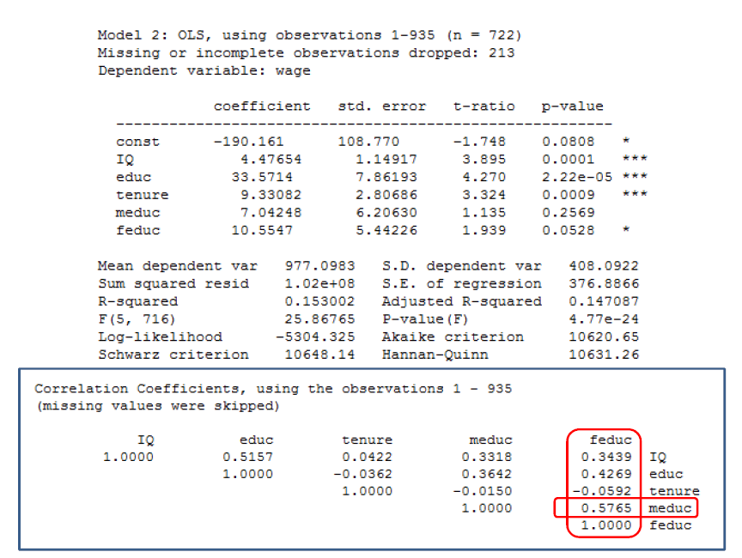

Slide 6
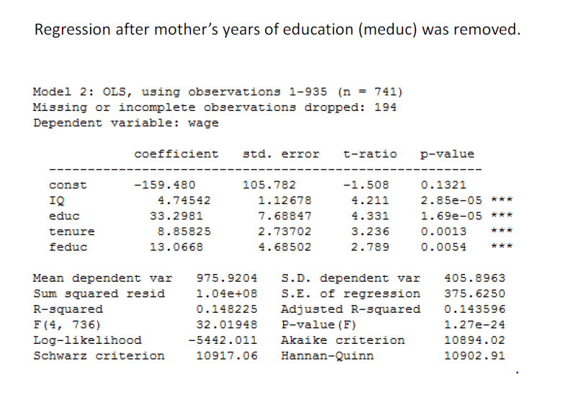

Slide 7
What to do?
Unfortunately the only real solution to colinearity is increasing your sample size. The increase in data will increase the precision of the slope estimates which will increase the precision of the slope estimates which will offset the increase in SD (X_{j})
Most of the time you can’t change your sample size though. The other options are:
Take the variable out. Look at the adjusted R2. If it increases when the variable is removed then that is probably the right course of action.
You can also just leave the variable in the regression. You can use a partial F-test to show that the group of collinear variables are jointly statistically significant even though their individual t-stats might not indicate individual statistical significance.

Slide 8
